Slide 1
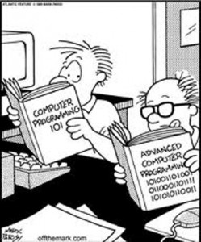
Intro to Python Programming
Hydroinformatics
October 2016
Dr. Dan Ames Brigham Young University dan.ames@byu.edu

Slide 2
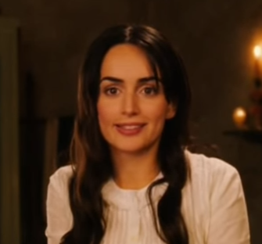
Re-Introduction…
Who is this Encarnacion?
https://youtu.be/qWSovC2-yM4?t=1m50s
Go to this link: https://goo.gl/aznZt4
Enter your name
Programming classes you’ve had
Rate yourself 1-10 in programming in general
Any experience with Python

Slide 3
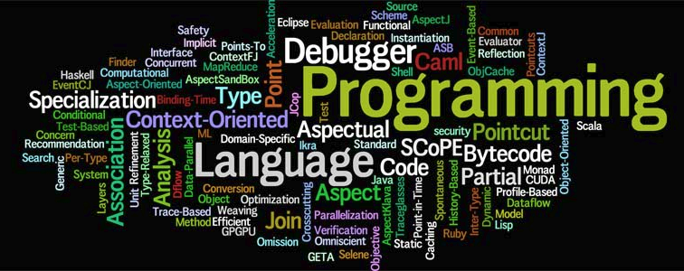
Key concepts in programming
Variables (integers, strings, dates, etc.)
Functions (list of steps the code will follow)
Classes (collections of functions and variables)
Flow control (if then, loop, etc.)
That’s pretty much it…

Slide 4
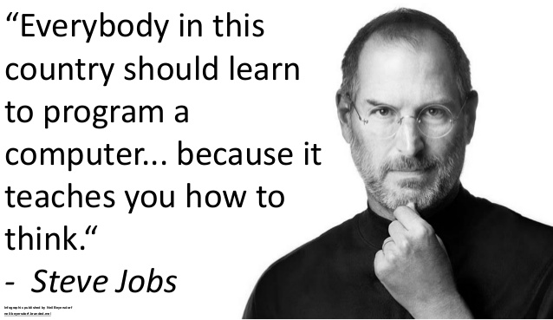
How we learn to program
Learn the basic concepts (i.e. in a class like this)
Google the syntax
That’s pretty much it…
“Hello world!” gallery…

Slide 5
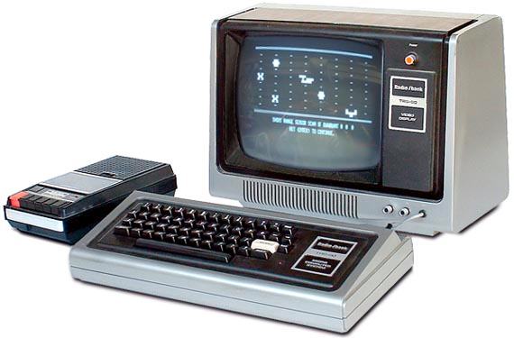
Trs-80 model 1
READY>> PRINT “HELLO WORLD”

Slide 6
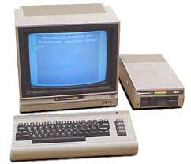
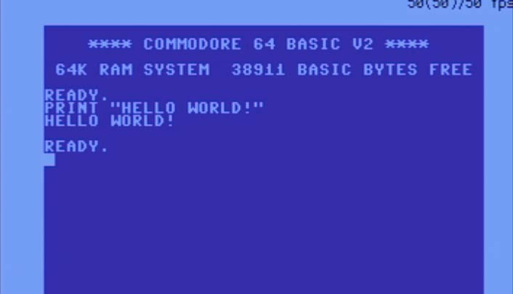
Commodore 64

Slide 7
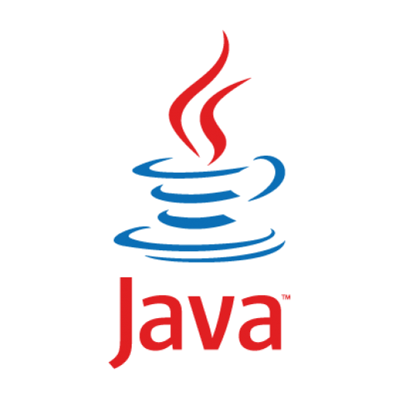
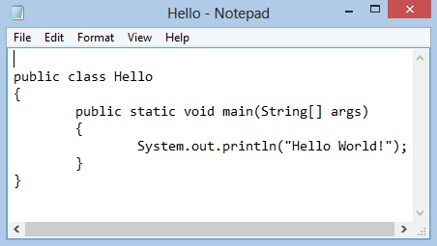
Java

Slide 8
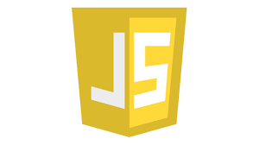
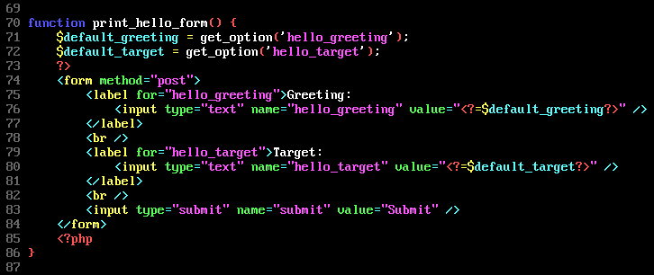
JavaScript

Slide 9
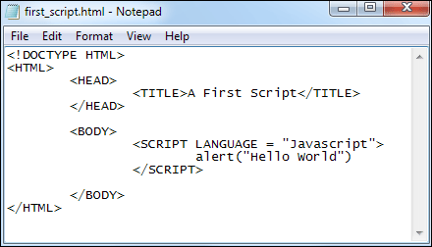
JavaScript

Slide 10
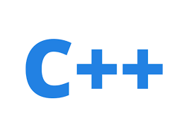
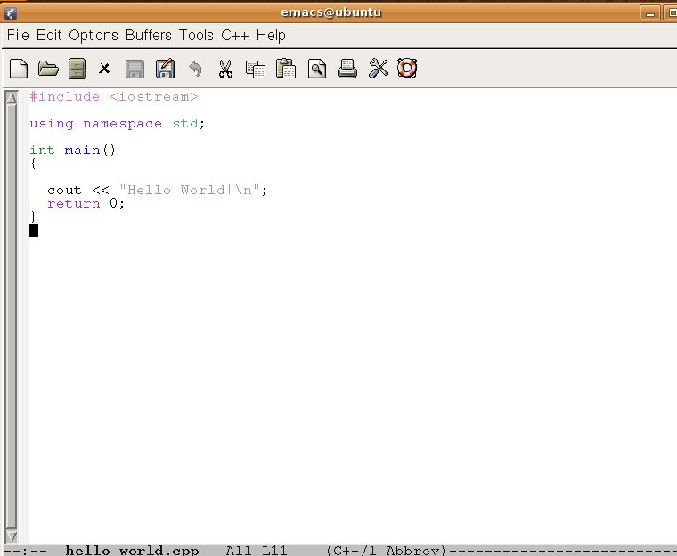
C++

Slide 11
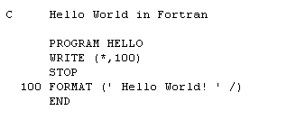
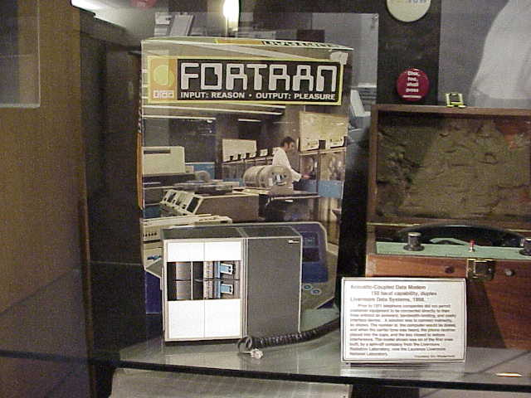
Fortran

Slide 12
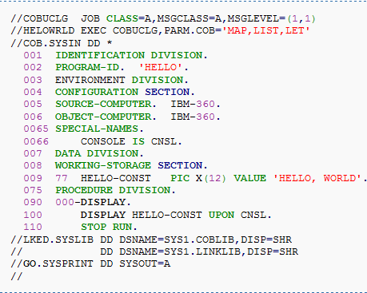
cobol

Slide 13
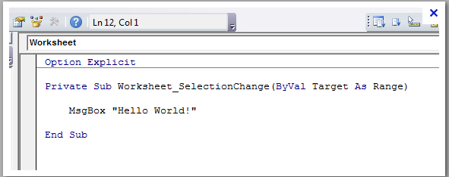
VBA

Slide 14
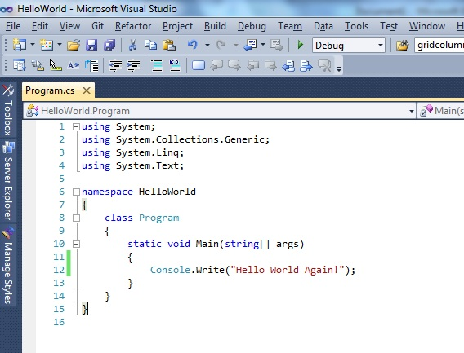
C#

Slide 15
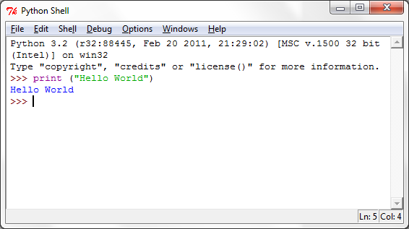
Python

Slide 16
Main Python Programming Concepts
Comments are identified by a # sign
Indentation matters to the meaning of the code:
Block structure indicated by indentation
The first assignment to a variable creates it.
Variable types don’t need to be declared.
Python figures out the variable types on its own.
Assignment uses = and comparison uses ==
For numbers + - * / % are as expected.
Special use of + for string concatenation.
Special use of % for string formatting (as with printf in C)
Logical operators are words (and, or, not) Simple printing can be done with print.
Notes:
16

Slide 17

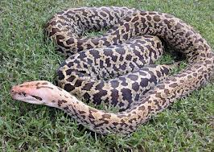
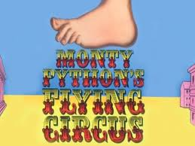

Python
But why is it called Python?

Slide 18
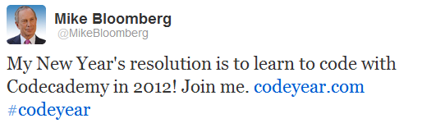
Anyone can program
Just as Mayor Bloomberg of NYC…

Slide 19
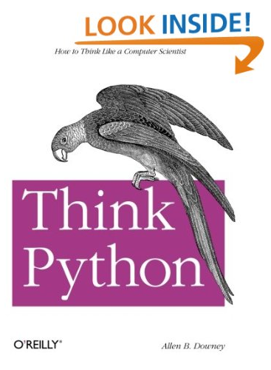
Python Resources
Think Python by Allen B. Downey
Free e-book (pdf).
Download it.
Put it on your e-device.
Read it and follow examples.
Become a better person programmer.
Save $30.
Take someone special on a date.
Become a better person!

Slide 20
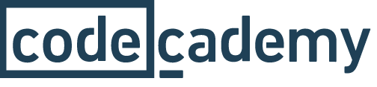

Python Resources
www.codecademy.com/learn/python
www.LearnPythonTheHardWay.org

Slide 21


Python Programming Development Environments
Eclypse with PyDev
Idle
Eric
PyScripter
Bluefish
Geany
Spyder
Notepad
PyCharm

Slide 22
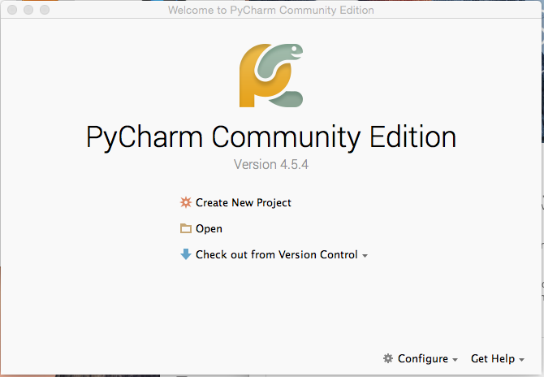
PyCharm

Slide 23
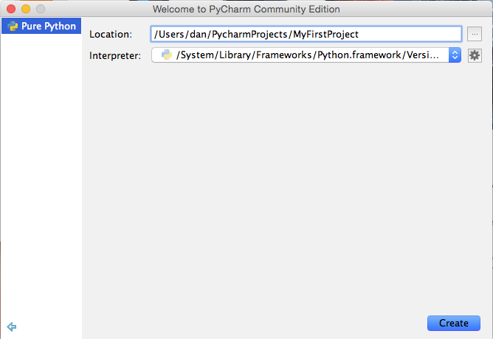
PyCharm

Slide 24
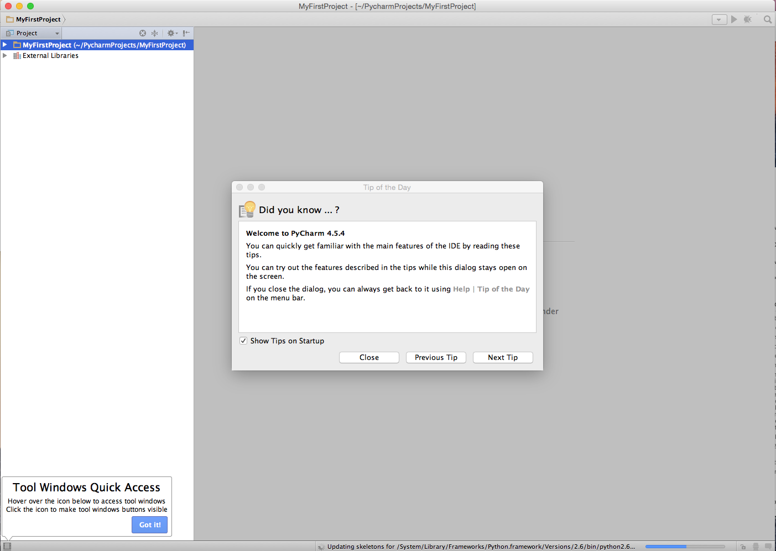

Slide 25
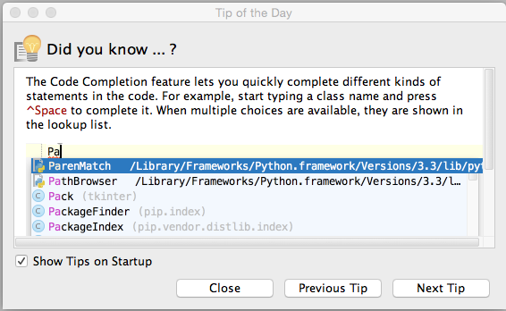

Slide 26
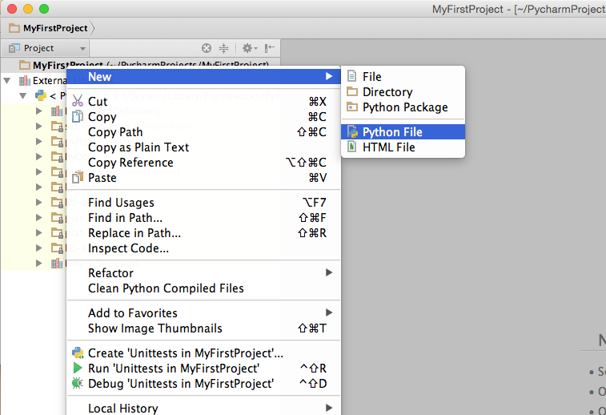

Slide 27
Experimenting with Python
Run the Python Console (under the Tools menu)
Try the following….

Slide 28
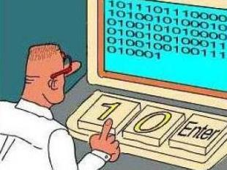
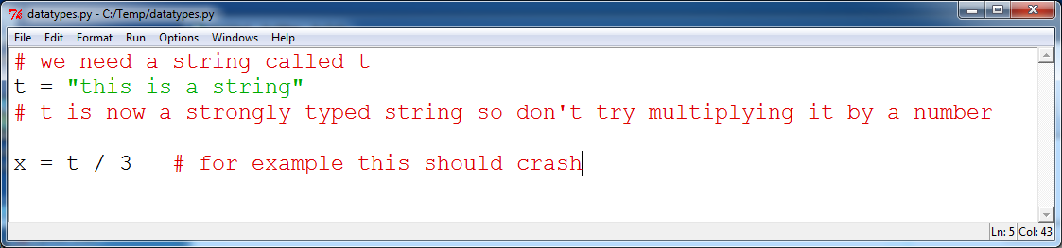
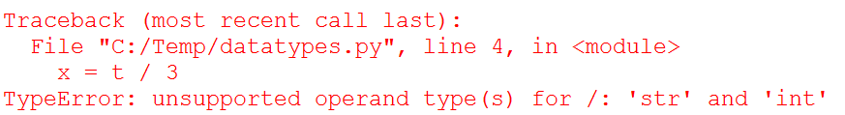
Working with python variables
Rules of the road:
Variables come into existence the moment you use them.
Variables become strongly typed the moment you use them.
So don’t misuse or abuse your variables.

Slide 29
Working with python variables
What are the main variable “types”?
str = String = a bunch of letters, numbers, symbols
int = Integer = integer numbers (no fraction)
float = Float = numbers with decimal points
How to test a variable type? Try these:
type("hello world")
type(17)
type(1.234)

Slide 30
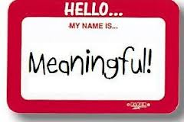
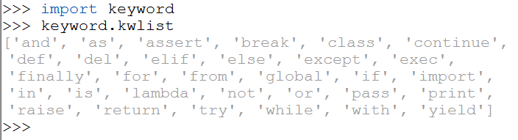
Working with python variables
What variable names are legal?
Choose meaningful names
No leading numbers, no spaces, basically the same rules as for VBA
Variables are generally lower case, functions are CapCase
Don’t use Python keywords

Slide 31
Python NUMBERS
>>> 2+3
5
>>> 2/3
0
Why is 2/3 Zero?!
>>> 2.0/3
0.66666666666666663
>>> x=4.5
>>> int(x)
4
How do you round?
Notes:
31

Slide 32
Python NUMBERS
Compute the volume of the original Death Star (d = 160 km)

Slide 33
Python NUMBERS
Compute the volume of the original Death Star (d = 160 km)
>>> import math
>>> d = 160.0
>>> r = d/2
>>> pi = math.pi
>>> V = 4.0/3.0*pi*r**3
>>> V
2144660.45...

Slide 34
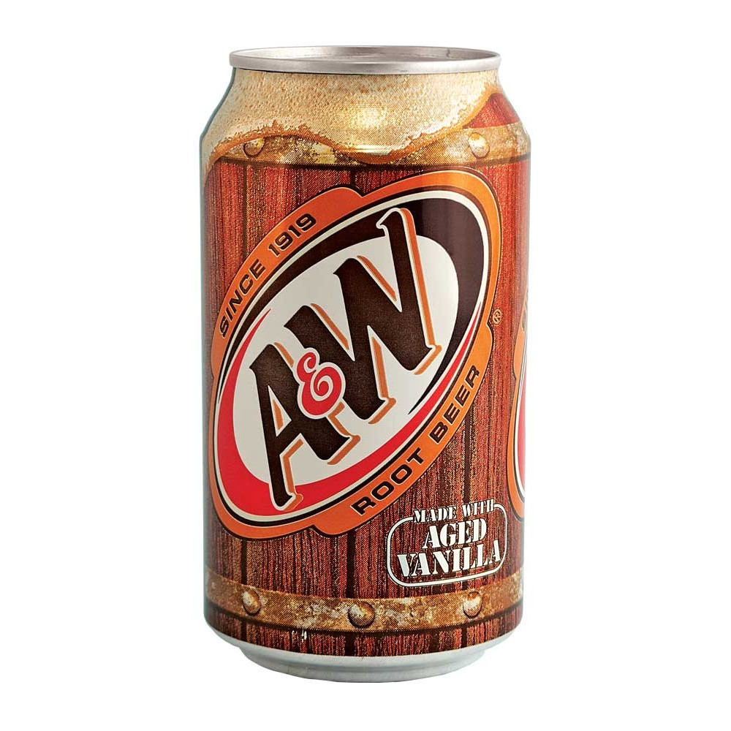
Python NUMBERS
You Try it!
Write a Python Expression to compute the volume (in mL) of a can of Root Beer that is 4.83 in high, & 2.60 in diameter.
Put your answer here:
https://goo.gl/aznZt4
Notes:
34

Slide 35
Python STRINGS
>>> myclass = "Hydroinformatics"
>>> myclass.upper()
'HYDROINFORMATICS'
>>> myclass.lower()
'hydroinformatics'
>>> myclass.count("i")
2
>>> myclass.replace("Hydro","Hidro")
'Hidroinformatics'
>>> myclass
'Hydroinformatics'
#What happened to our change?
>>> newclass = myclass.upper()
>>> newclass
'HYDROINFORMATICS'
Notes:
35

Slide 36
Python STRINGS
>>> x='abc'
>>> x[0] #Notice you can treat a #string like a list…
'a'
>>> x[1:3]
'bc'
>>> x[:2]
'ab’
>>> x[1]='d'
Traceback (most recent call last):
File "<pyshell#14>", line 1, in <module>
x[1]='d'
TypeError: 'str' object does not support item assignment
#sort of…
Notes:
36

Slide 37
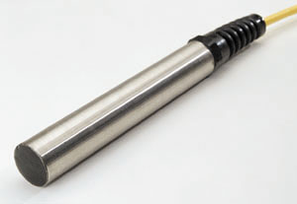
Python STRINGS
You Try it!
Write a Python Expression to extract the 3rd data value from this string of data from a sensor:
temp -999 -999 21.2 22.6
Put your answer here:
https://goo.gl/aznZt4
Notes:
37

Slide 38
Python LISTS
>>> x=['a','b','c']
>>> x[1]
'b'
#why isn’t it ‘a’?
>>> x[1:]
['b', 'c']
>>> x[1]='d'
>>> x
['a', 'd', 'c']
>>> x[1]=99
>>> x
['a', 99, 'c']
#Is that weird?
>>> y = range(10)
>>> y
[0,1,2,3,4,5,6,7,8,9]
Notes:
38

Slide 39

Python LISTS
You Try it!
Write an expression to create a list of the months of the year and extract the 3rd month.
Put your answer here:
https://goo.gl/aznZt4
Notes:
39

Slide 40
Python FUNCTIONS
>>> import math #Load the math library
>>> def pythag(a,b):
... return math.sqrt(a**2 + b**2)
...
>>> pythag(3,4)
5.0
>>> pythag(5,12)
13.0
>>> pythag(pythag(3,4),12)
13.0
#How do you pass params into the function?
#How do you return results from a function?
Notes:
40

Slide 41
Python FUNCTIONS
You Try it!
Write an function to return the volume of any arbitrary cylinder given the diameter and height.
Put your answer here:
https://goo.gl/aznZt4
Notes:
41

Slide 42
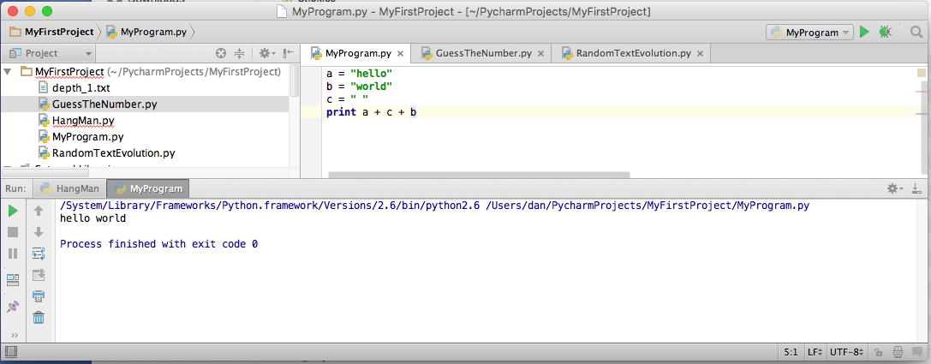
Using a script file
Start PyCharm, Create a new file, Paste your code into the file
Save the file, Run the script using the “Run” menu
Drop down to select your script
Type your script
Run your script
Output is displayed here

Slide 43
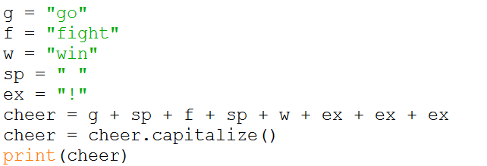
Using a script file
Try a simple string concatenation…

Slide 44
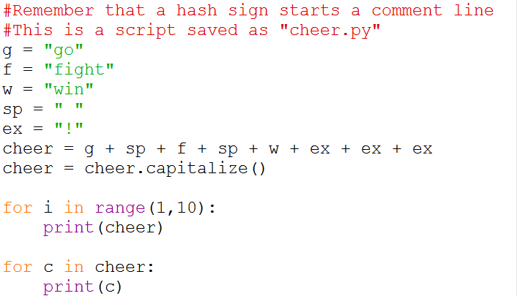
Using a script file
Now let’s use a couple of loops…

Slide 45
Using a script file
Now try an if-then statement…
x = 34 - 23 # A comment.
y = “Hello” # Another one.
z = 3.45
if z == 3.45 or y == “Hello”:
x = x + 1
y = y + “World” # String concat.
print x
print y

Slide 46
Three useful modules
What is a module?
Like an “extension” or “plugin”
Adds additional functionality to Python, not in the core environment.
In the interpreter type, help("modules") to get a list of all currently installed modules.
Use a module in your code, first import it:
import os
import shutil
import math

Slide 47

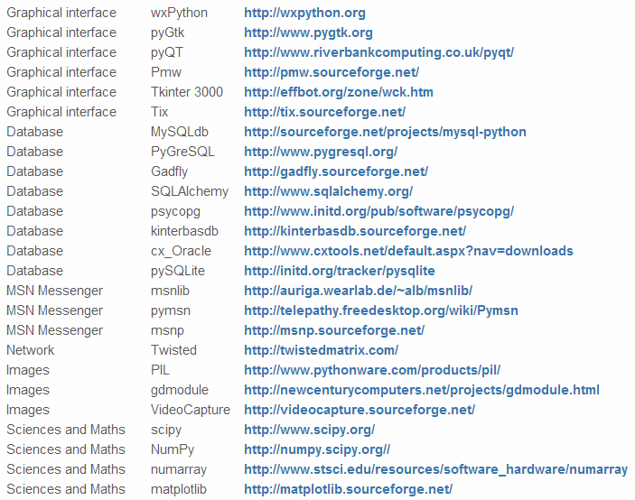
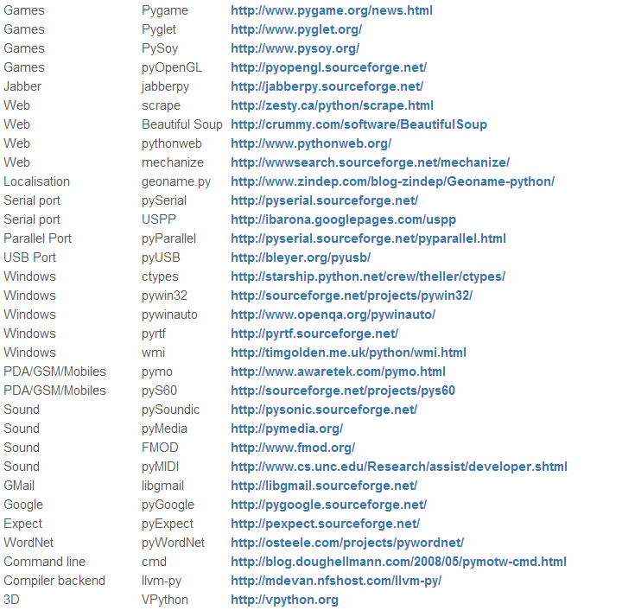

Python Modules
50 Top Python Modules (from www.CatsWhoCode.com)
Think Legos…

Slide 48
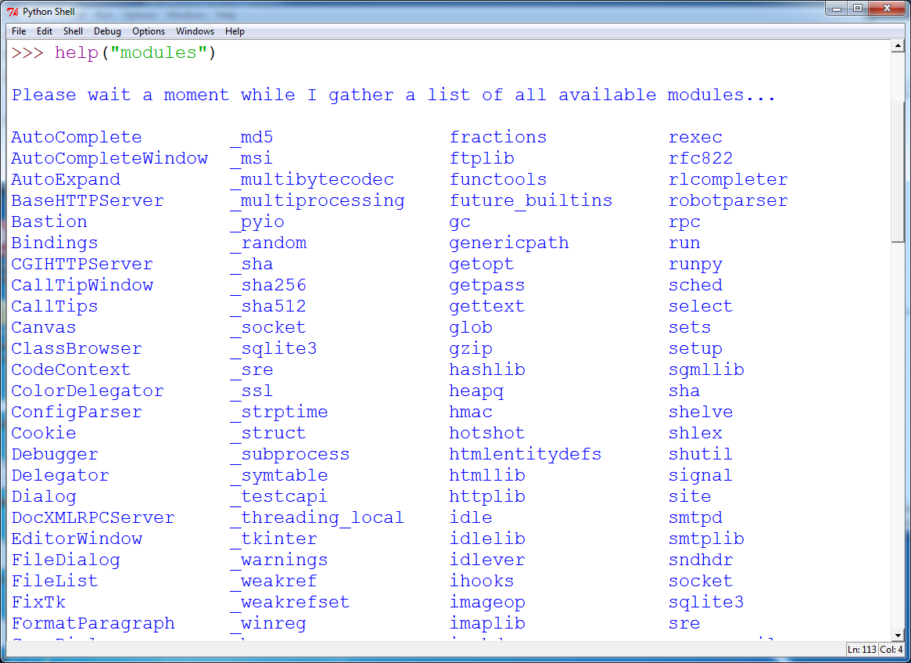
Here’s how to see what modules you currently have loaded…

Slide 49
Four useful modules
os: functions for working with your operating system including file management
shutil: high level functions for working with files
MatPlotLib: make graphs, charts, and maps
pymysql: functions for accessing and working with data in an SQL database

Slide 50
Module: OS
Let’s look at the module, “os”
Think of it as a connector into your current operating system
Use it to do useful file level activities
os.getcwd() returns the current working directory
os.curdir returns the current directory
os.execl executes an executable file
os.abort fails in the hardest way possible
os.listdir returns a list of strings of names of entries in a folder
os.path.exists() tests whether a path exists
os.path.basename() returns the final component of a path name
os.path.isdir() returns true for a directory, false for a filename

Slide 51
MODULE: shutil
Let’s look at the module, “shutil”
Think of it as a high level file/folder manipulator
shutil.copy, copyfile, copytree copy things
shutil.abspath returns the absolute path to a file
Shutil.fnmatch test if a file path matches a pattern
shutil.move move a file or folder to another destination
shutil.rmtree recursively remove the contents of a directory tree

Slide 52
MODULE: MatPlotLib
Let’s look at the module, “MatPlotLib”
Makes (pretty) pictures
MatPlotLib.pyplot.plot Plot a graph of data.
MatPlotLib.pyplot.show Show the user your graph.
Tutorial here: http://matplotlib.org/1.3.1/users/pyplot_tutorial.html
Gallery here: http://matplotlib.org/1.3.1/gallery.html

